Slide 2

Cro-Fu
FusionFabric CrowdFunding Platform
Paris Hackathon ‘15
FusionReactor Project initiated by B. Pulatov & K. El Mourabet
Notes:
Cro-Fu is the Hackathon counterpart to the Fusion Reactor CrowdFunding project
The original contributors were Bakthier Pulatov and Karim El Mourabet.
This should serve as evidence in the CrowdFunding case that we,Misys should build this solution … now.

Slide 3

What is CrowdFunding?
Funding of Projects by Individuals
CFPs are Online Marketplaces
$34bn in yearly transactions
Expected $1tn by 2020
1,000,000,000,000
Notes:
Crowd Funding is an online market place were projects meet funders.
This is an alternative to traditional lending business.
As we speak, there are over 1300 platforms that process $34bn per year.
The target market size for 2020 is $1tn
That is one million, million dollars.

Slide 4

Why Misys and Fusion Crowdfunding?
Technology
Fusion Fabric ⇨ Performance, Scalability
Brand Recognition
CCS + Loan IQ ⇨ FusionBanking Lending
Strategy & Culture
Customer Success ⇨ Bank 3.0 Transformation
High Performance Culture ⇨ Marketplace + Challenge
Outstanding Financial Performance
Notes:
Mysis is specially fit for this solution
<click>
Our technology is perfect match for the need. High Performance, High availability, SOA.
<click>
Our market position is ideal : We have the perfect Client Base with retail and commercial banks and Functional expertise with our existing lending offering: Former CCS and LoanIQ
<click>
We want to help retail and commercial banks to transform the way they interact with their clients (offering new products). This is shaping banks of the future. The 3.0 Banks.
Building a 24/7 solutions for 100k+ users is a steep performance challenge.
This is a juicy greenfield market for us, with great potential for upsell.

Slide 5

Hackathon Challenges
Integration with Banks Systems
Website & Rest Services,
Scalability
Global Retail Base ⇨ 24/7
Multi node FF
Artificial Intelligence
Projects Cherry Picking
Notes:
We would like to showcase 3 aspects of the solution in the context of this hackathon
<click> The system needs to integrate to existing bank website.
<click>
It needs to be able to cope with large volumes.
<click>
It needs to be smart enough to maximize platform profit by cherry picking projects based on user profiles

Slide 6
Demo

Slide 7


Websites Integration
Notes:
What we see here is an existing HSBC website that leverages FusionFabric services to enable CrowdFunding offering.
As a user I can log into my bank website and browse existing projects
<drill crowd funding>
In this list, I can pick whatever project is relevant to me,
<drill in project>
See what the current state is, and either contribute or Follow this project for later
Let s make a donation
<click donate>
From here
<open sources list>
I can choose where the money comes from
<type in amount>
Enter the amount I wish to donate
<click donate and close thank you>
I can then go back to this project
<reopen project status>
And see that progress has been recorded.

Slide 8

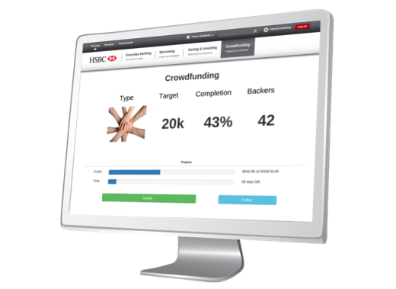

Demo Architecture
Notes:
In order to cope with volumes, we have implemented a multi node FusionFabric architecture, leveraging Cargo and NGINX (the load balancer)

Slide 9
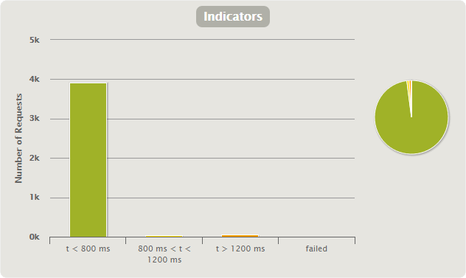
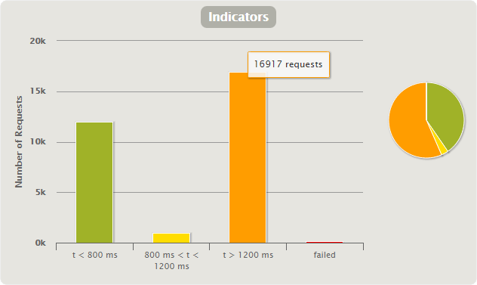
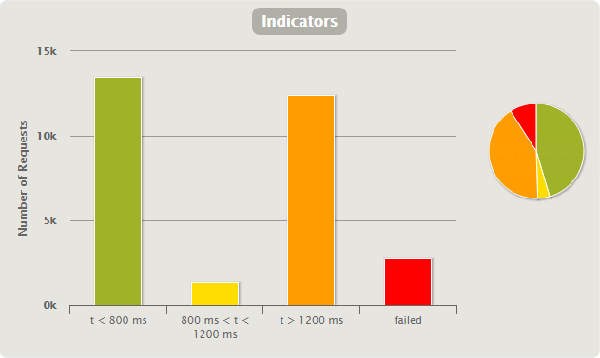
Scalability
1k users / 1 node : 98-1-1-0
10k users / 1 node : 45-4-41-9
10k users / 2 nodes : 40-4-56-0

Slide 10
Artificial Intelligence

Slide 11
Conclusion

Slide 12
Takeaways
Market is Ripe for this Solution
Misys is the Perfect Provider

Slide 13


Still not convinced?
I am positive this is great concept
Vote for Cro-Fu
Notes:
If all of the above has not convinced you, we have marketing fallback
Reveal Kate
That is targeting all audiences
=> Reveal dude

Slide 14
Frederic Andre, Marie-Lise Hamel, Jean-Cedric Jollant, Laurent Lhermine Consultants: Romain Gilles, Yoan Maman, Humberto Pereira

